Slide 1

General human mobility models
Rory Gibb, PHID group meeting, November 2021

Slide 2
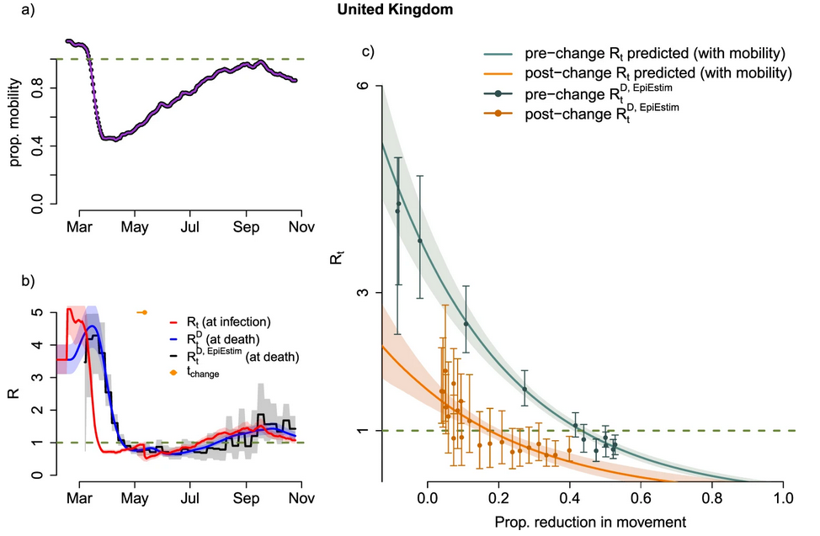
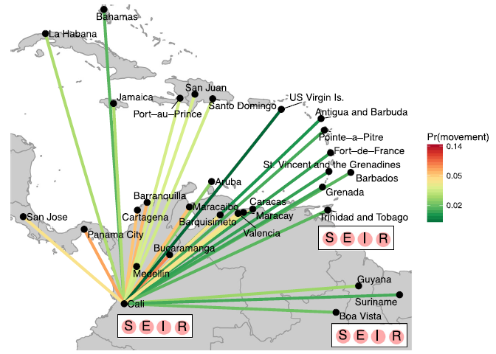
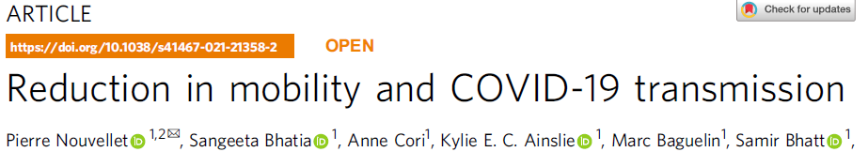
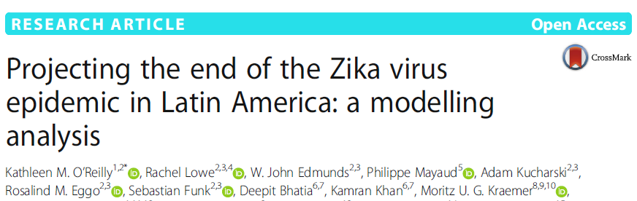
Mobility is a major driver of disease dynamics and spread in people…
Lockdown restrictions and COVID-19 in the UK
Spatial spread of Zika in the Americas

Slide 3
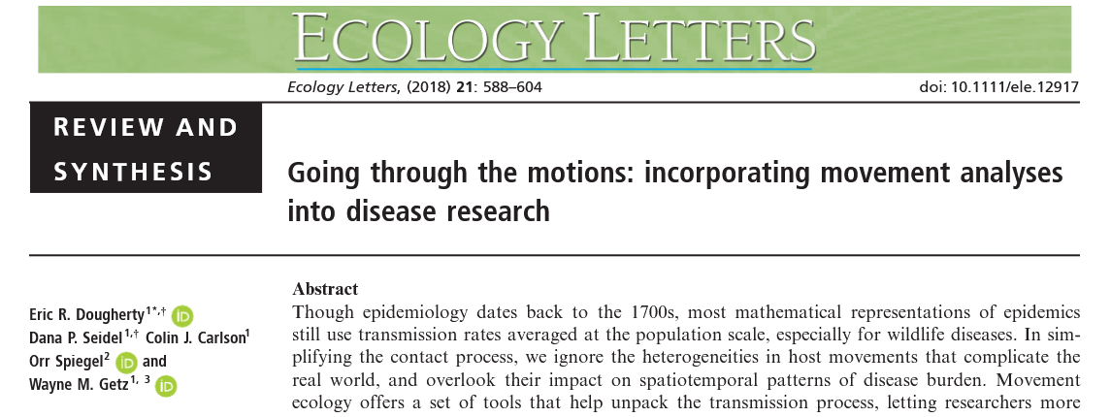
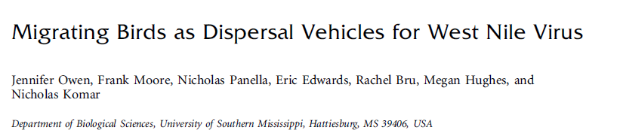
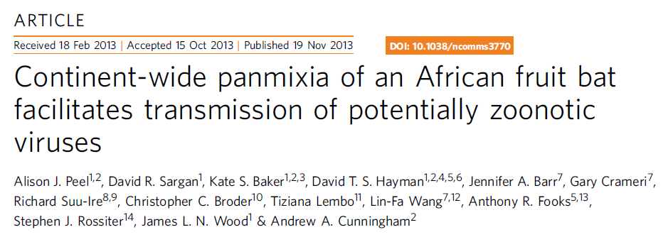
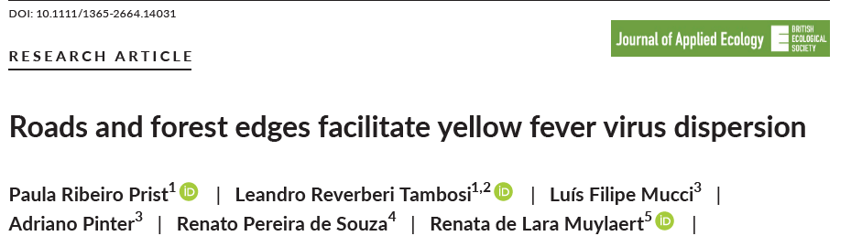
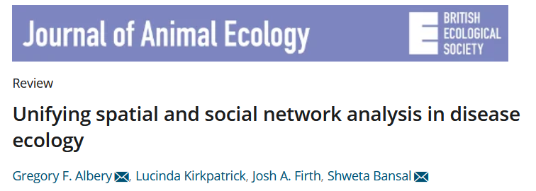
… and in wildlife

Slide 4
The problem
It is very challenging to measure (human) movement at the temporal and spatial scales required to incorporate into statistical or dynamical models of disease spread

Slide 5
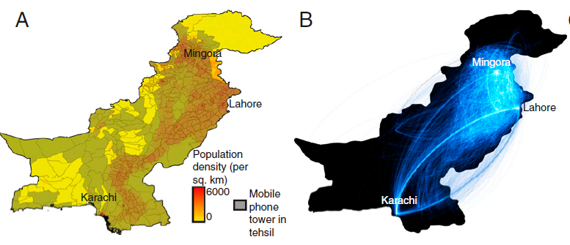
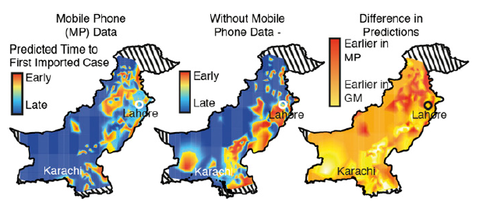

One emerging solution: mobile data
Pakistan population
Main travel routes from mobile phone data
Mobile phone data helps in predicting long-range introductions during 2013 dengue epidemic

Slide 6
One emerging solution: mobile data
But…
Challenging and slow to access
Spatially/temporally restricted (e.g. within country or few years)
Privacy and consent concerns
Pakistan population
Main travel routes from mobile phone data
Mobile phone data helps in predicting long-range introductions during 2013 dengue epidemic

Slide 7
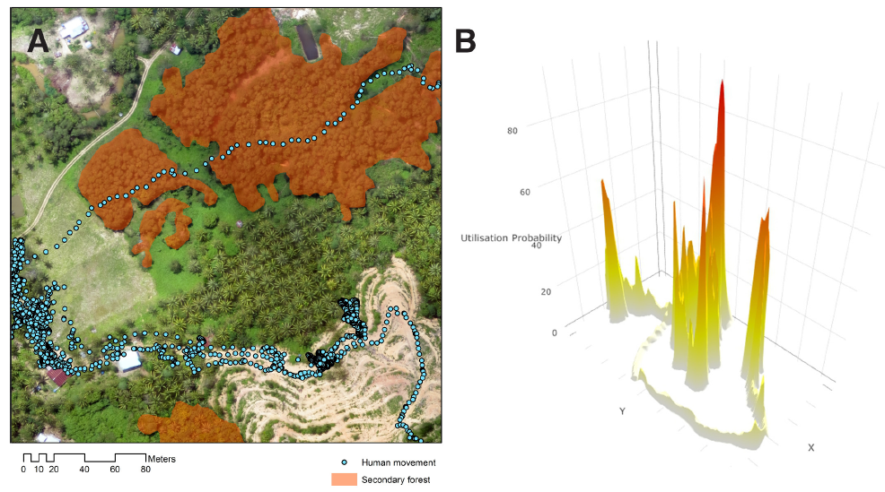
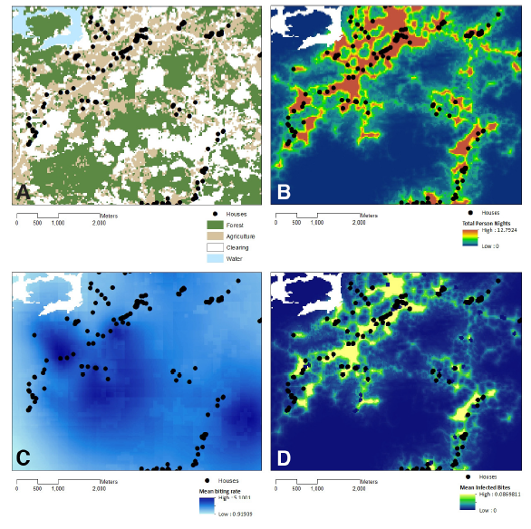
Another solution: GPS or other devices
Predicted distribution of infectious mosquito bites
(P. knowlsei)
Individual activity spaces characterized using GPS…
Predicted overall distribution of human activity
Fornace et al. 2019, eLife

Slide 8
Another solution: GPS or other devices
Predicted distribution of infectious mosquito bites
(P. knowlsei)
Individual activity spaces characterized using GPS…
Predicted overall distribution of human activity
But…
Expensive and labour-intensive to collect
So generally small-scale and short-term – appropriate for landscape studies but not necessarily large-scale epidemiological work
Fornace et al. 2019, eLife

Slide 9
Are there general “rules” of movement governing the likelihood of individuals moving from one location to another?
(Movement ecologists measure and predict these sorts of rules for wildlife, based on tracking or capture data – we tend to call them “resource selection functions”)

Slide 10




Some assumptions underpinning general human movement models
Proximity
Attractiveness
All else being equal, people are more likely to travel to more nearby locations
People are more likely to travel to more populated locations, due to greater economic and social opportunities

Slide 11
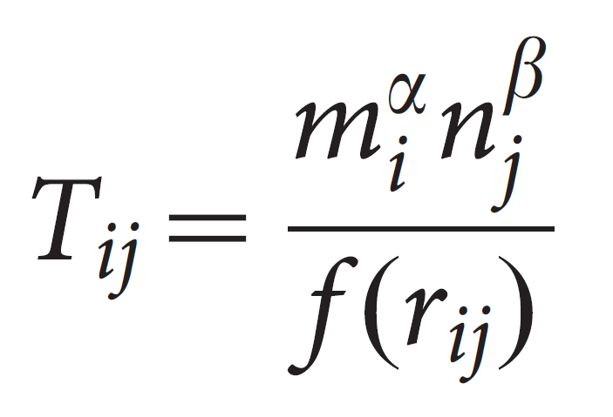
The gravity model
m_{i}
PopulationSource^{α} * PopulationDest^{β}
=
f(Distance)
r_{ij}
Simplest formalization of the two assumptions: the relative flux (or probability of movement) between two locations is proportional to some power of source and destination populations, penalized by a function of the distance between them
Fast, flexible and widely used across economics, migration and epidemiology settings, but requires setting-specific mobility data to estimate attractiveness and distance-decay parameters (or some substantial assumptions)
n_{j}

Slide 12
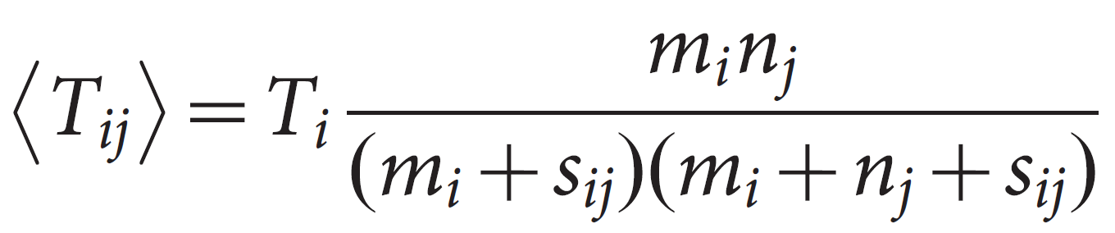
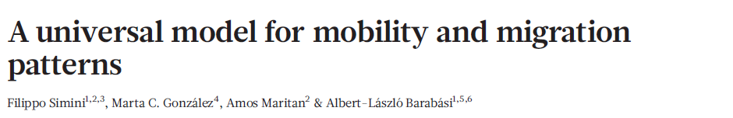
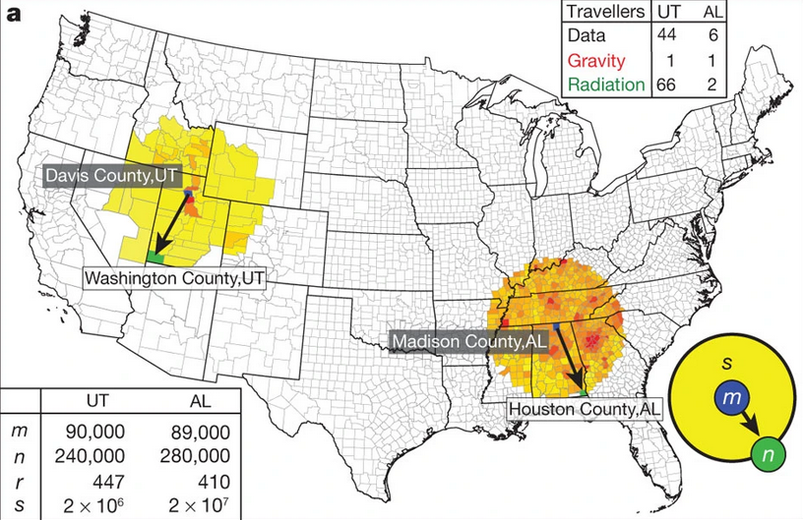
The radiation model
Total population within the radius r_{ij}
Based on the same principles as the gravity model, but also accounts for the competitive pull of other densely populated areas more nearby than the destination.
Relative fluxes between destinations are parameter-free – so can be applied without using context-specific data.
However, developed and validated against USA mobility information – how generalisable?
Simini et al. 2012, Nature

Slide 13
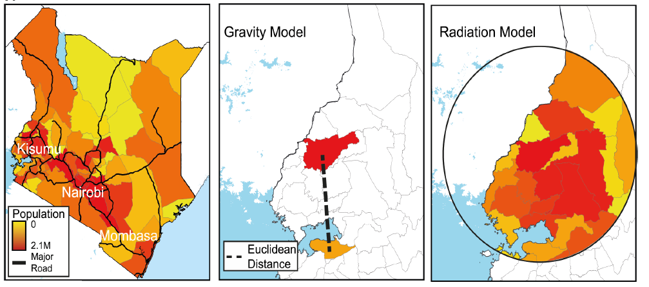
Comparative schematic of gravity and radiation models
Wesolowski et al. 2015, PLoS Comp Biol

Slide 14
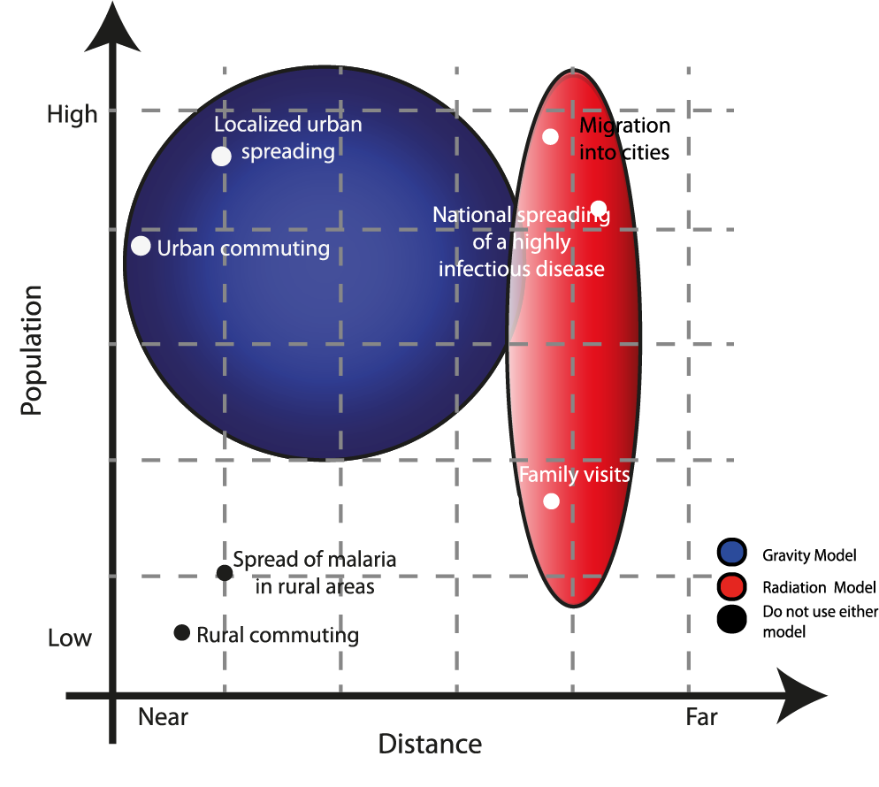
A comparison of gravity and radiation model applications in LMIC settings
General guidance based on comparison of performance against mobile phone data in several African countries (but may be difficult to apply in practice)
Wesolowski et al. 2015, PLoS Comp Biol

Slide 15
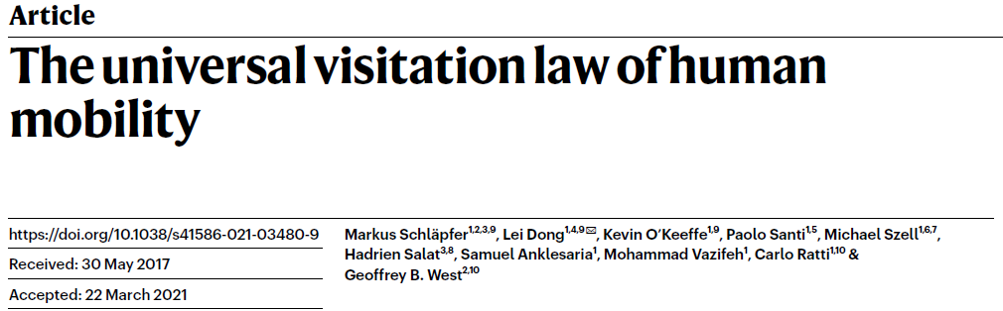
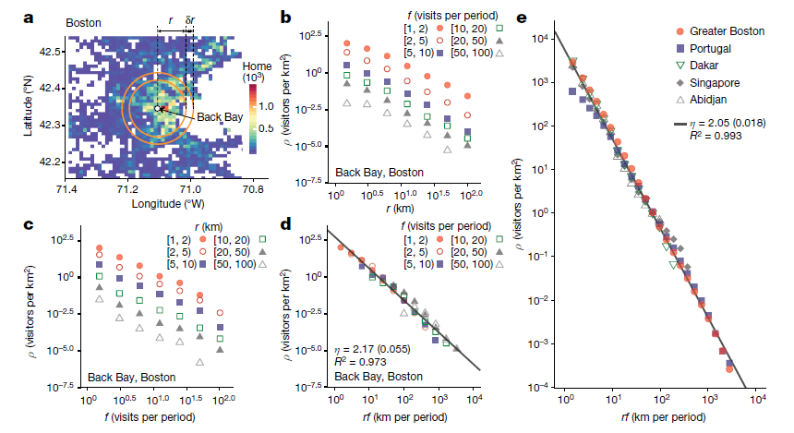
More proposed “universal” laws of mobility..
There are likely to be many useful forms of human mobility models – in many cases incorporating some mobility proxies may be better than including none
Schlapfer et al. 2021, Nature

Slide 16
Advantages and disadvantages of different mobility models
I ran out of time to do this.
If it is useful, I can do this and add it to the GitHub repo – let me know.

Slide 17
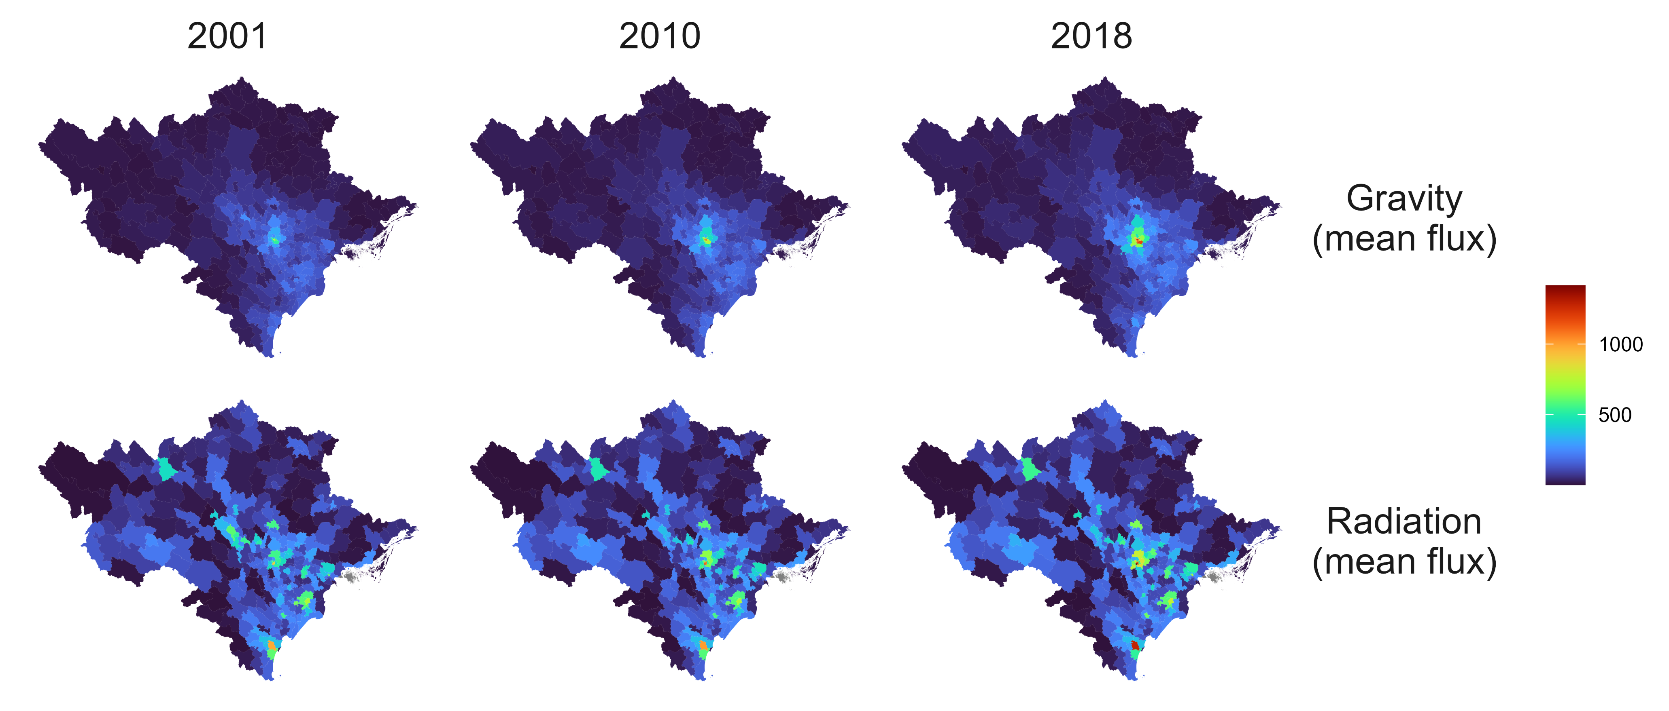
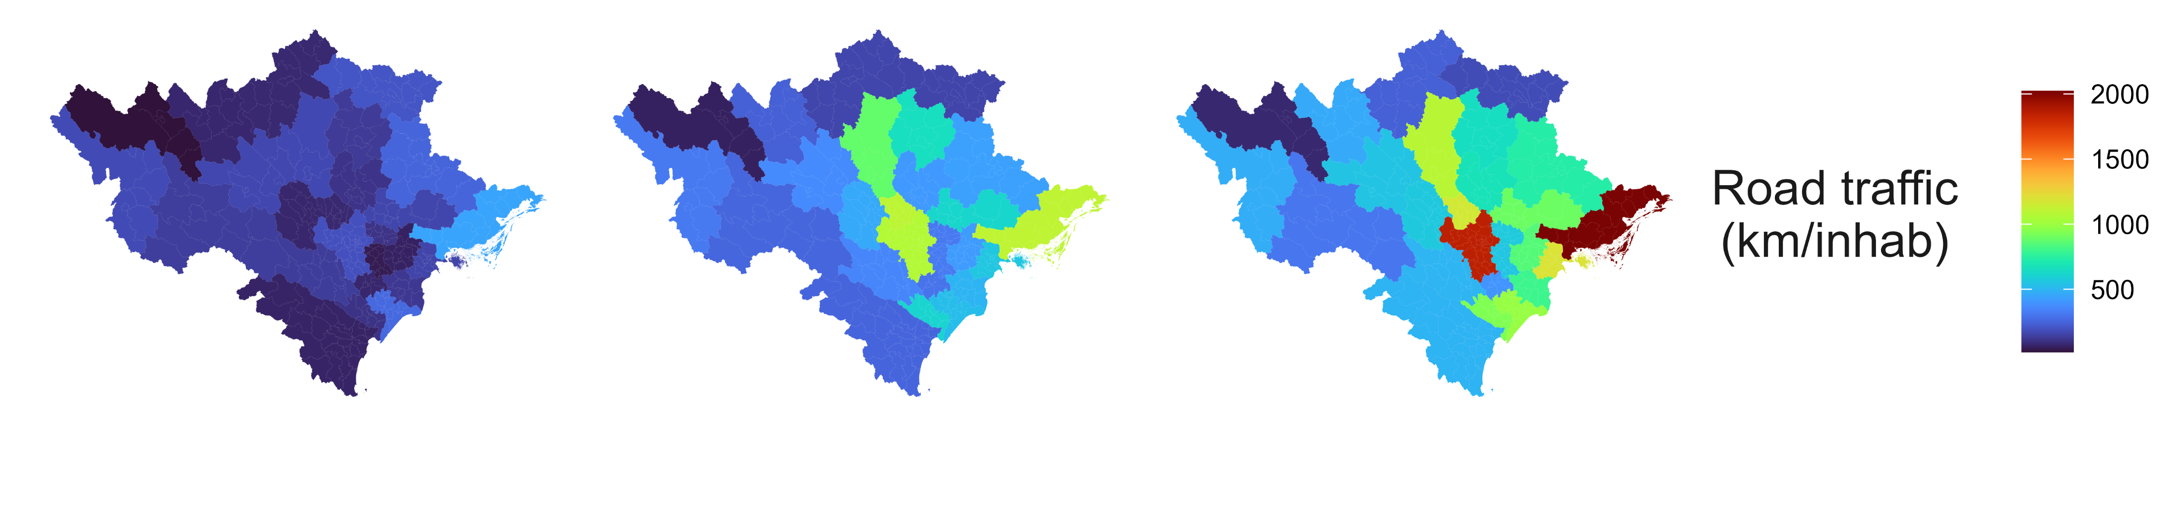
Example: long term mobility trends in north Vietnam

Slide 18
Some tutorial code in R
https://github.com/rorygibb/phid_mobility

